Slide 1

Climbing Data Mountain Web Based Data Visualizations in NVD3.js and D3.js
Dustin Ewers
Consultant @ Centare
Code: https://github.com/DustinEwers/d3-demos-data-mountain
Website: www.dustinewers.com
Twitter: @dustinjewers
Notes:
Slide background from: www.subtlepatterns.com

Slide 2

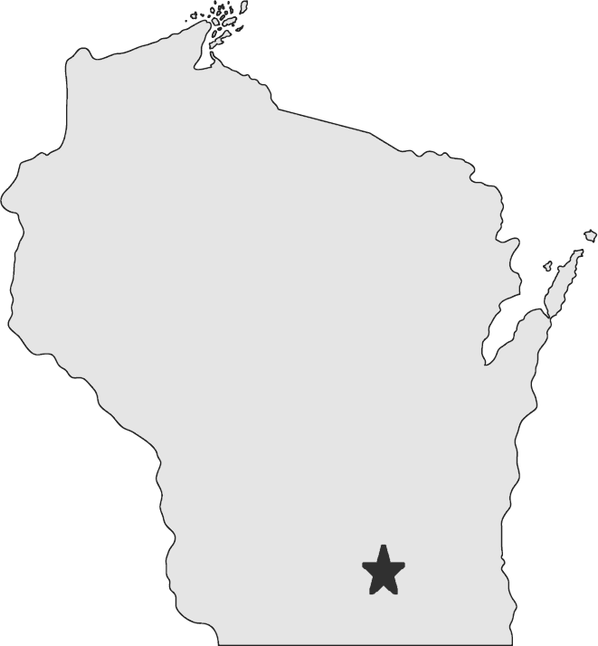

My Story
Notes:
10 years of Web Dev on the Microsoft stack
Hail from the Hipster Capital of the Midwest, Madison
We are awash in data, so I’m trying to learn different tactics to deal with it
My math skills could use some work, but web based data viz seems like a good entry point

Slide 3
Roadmap
Why Bother?
Charting Best Practices
Web Based Charting
Intro to D3.js
Demos

Slide 4
What’s so great about data visualization anyway?

Slide 5
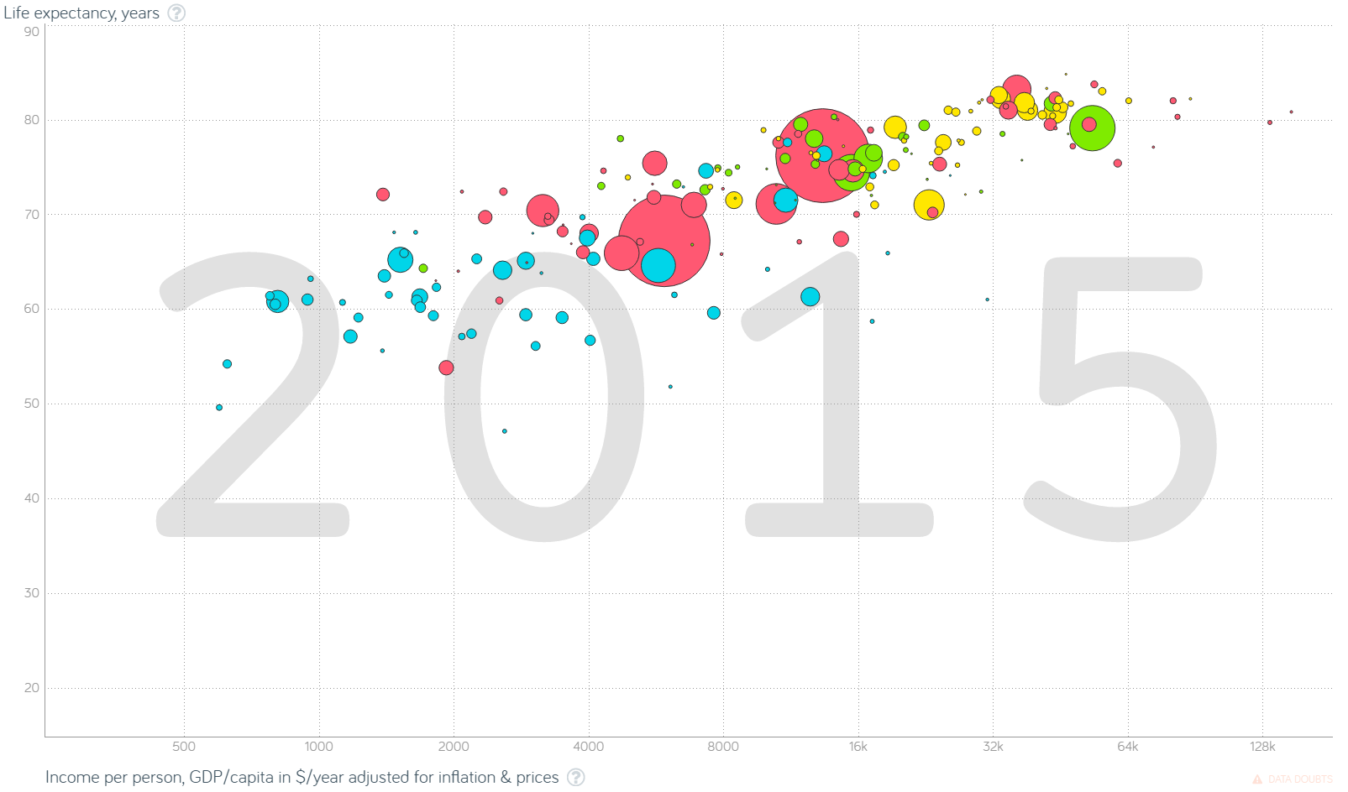
Notes:
Actually shell out to the website if I can.
Major points:
1. There’s a ton of data here. Each data dimension is an excel spreadsheet.
2. The animation tells a very interesting story
3. Easily accessible by nearly anyone
4. People can actually handle the data (it’s interactive)
http://www.gapminder.org/tools/#_locale_id=en;&chart-type=bubbles

Slide 6
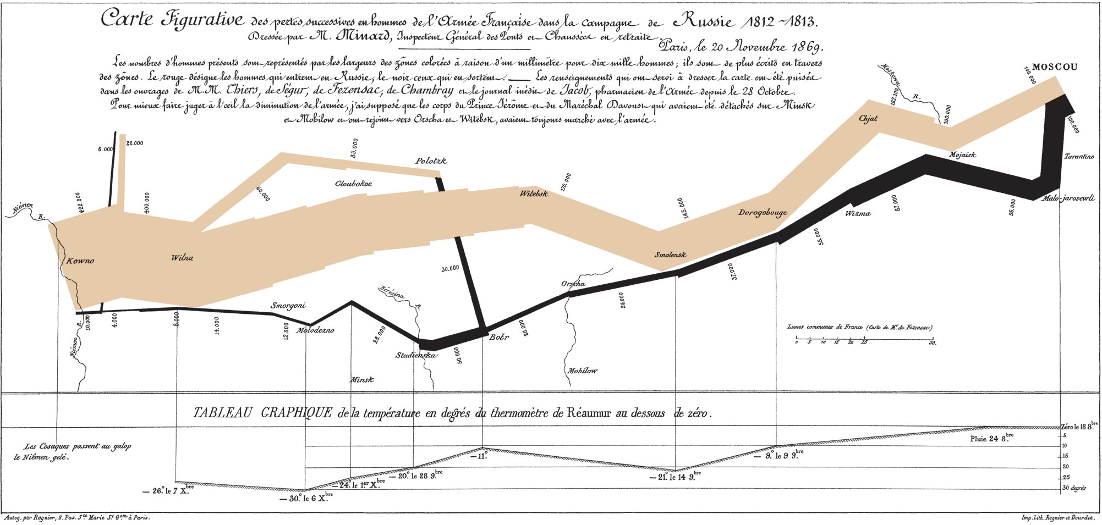
Notes:
https://en.wikipedia.org/wiki/Charles_Joseph_Minard
This data viz tells a story about Napoleon and his followers.
Doesn’t even need to be high tech… This is from 1869

Slide 7
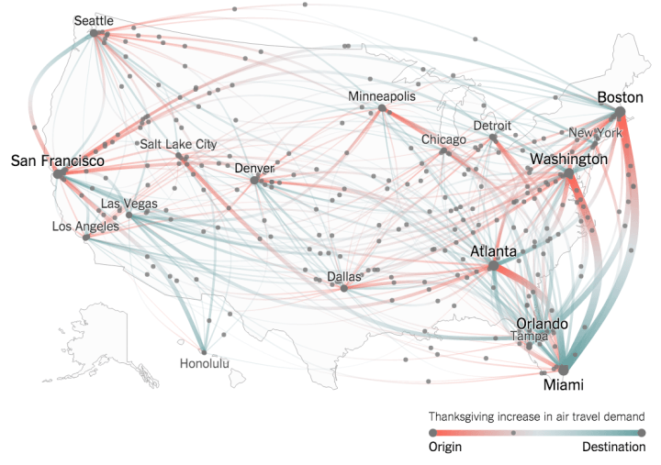
Notes:
https://www.nytimes.com/interactive/2015/11/24/upshot/thanksgiving-flight-patterns.html
Data viz gives you a better overview of the data than statistics would.

Slide 8
How do we make it not suck?

Slide 9
Bad
Notes:
This chart is loaded with extra details that don’t communicate information.
Also known as “chart junk”
Gradient, stupid 3d effects, etc...

Slide 10
Also Bad
Notes:
This chart lacks axes and explanations.

Slide 11
Better
Notes:
Avoid “chart junk”
Use visual ques to denote information, but don’t over embellish

Slide 12
Notes:
Scales should start at zero
Avoid any trickery with scaling too

Slide 13
Web Based Charting Tools
Kendo UI
Chart.js
Google Charts
High Charts
Notes:
Dime a dozen…
Usually reasonably easy to use…
http://www.chartjs.org/
https://www.highcharts.com/products/highcharts
http://docs.telerik.com/kendo-ui/controls/charts/overview
https://developers.google.com/chart/

Slide 14

Data
Driven
Documents
Notes:
Mike Bostock | 2011
D3 = Data Driven Documents
Data Visualization Toolbox
Uses Web Standards to make charts

Slide 15

Notes:
D3 is the laser chain saw of visualization tools
It’s a powerful library and has lots of features:
Scroll through the API documentation:
https://github.com/d3/d3/blob/master/API.md

Slide 16
When to Use D3.js
DIY Charting Library
Unique Visualizations
Need Low Level Control
Notes:
DIY Charting Library
- Build the basis for a company wide charting library
Unique Visualizations
- Need something that the standard charts can’t handle
Need Low Level Control
- Lots of people come to D3 after their regular charting stuff doesn’t work out

Slide 17
When not to use D3.js
Old web browsers
Need something easy
No advanced usages
Notes:
Old web browsers
- D3js is not great on older web browsers
Need something easy
- D3 is not easy, you’re going to spend a lot of time fiddling with SVG
No advanced usages
If you just need a barchart, don’t spend the effort
D3.js is a high effort, high reward tool

Slide 18
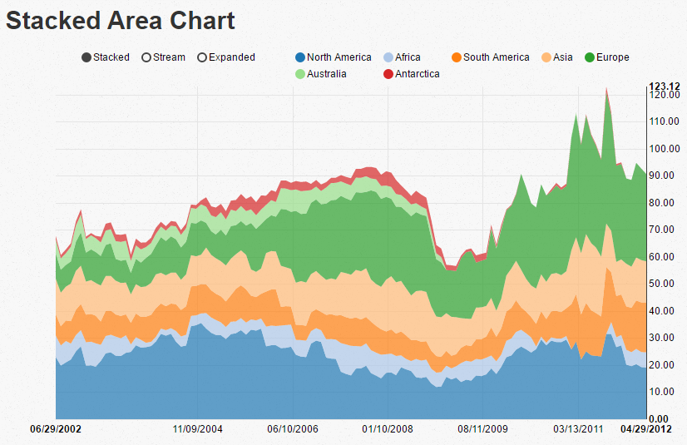
NVD3.js
Supported Charts
Line
Bar
Bubble
Area
Pie
Bullet
Notes:
D3.js charts
Easier to use than D3.js
Uses the older version of D3, which is annoying.
D3 v3 vs. D3 v4

Slide 19

Notes:
What’s the best way to learn d3.js?
The best way to learn D3.js is to review examples, replicate them, and tweak them. The api documentation is okay, but it’s not going to get you there.
Unfortunately, most of the examples you’re going to encounter are in old versions of D3.js (v3)
The new API is similar, but you’ll have to update.
https://github.com/d3/d3/wiki/Gallery
https://www.pexels.com/photo/library-high-angle-photro-159775/
----------------
https://github.com/d3/d3/blob/master/API.md
https://github.com/d3/d3/wiki/Gallery
http://alignedleft.com/work/d3-book
https://github.com/d3/d3/wiki/Tutorials#d3-v4
http://shop.oreilly.com/product/0636920037316.do

Slide 20
D3.js Concepts

Slide 21
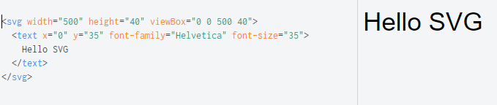
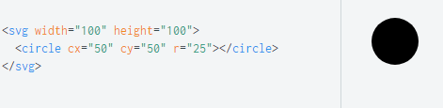
SVG
Notes:
Scalable Vector Graphics
D3.js uses SVG extensively
Just like HTML
Can take on click events
Can be styles with CSS
https://developer.mozilla.org/en-US/docs/Web/SVG
A few examples:
Circles
Squares
Lines
Groups
Text

Slide 22
Data Loading
Supported formats:
JSON
TSV/CSV
XML
Notes:
D3 has lots of methods to import data.
The default binding is to take a JS object and bind it to some SVG, but D3 has utilities to take in lots of formats.

Slide 23
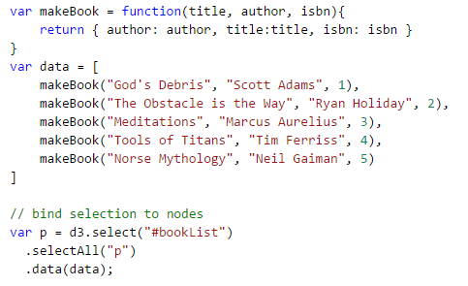
Data Binding
Notes:
Select grabs the element, like jQuery
Select all tells D3 what we’re binding to
Data does the actual binding.
-- This is conceptually similar to what you’d do in an Angular or Knockout app
--

Slide 24
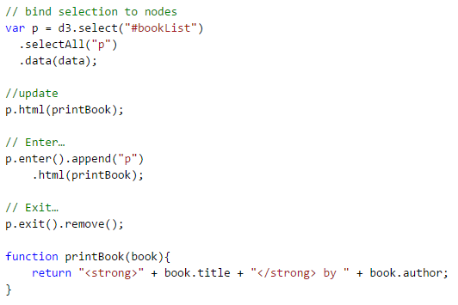
D3.js Events
Notes:
Think of your visualization like a stage.
Update –happens when an item changes
Enter – when it enters
Exit – when it leaves

Slide 25
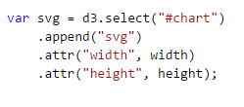
Transformations
Notes:
We can add or remove elements
We can change attributes, classes, etc…
You can also add transition animations
A lot like jQuery.

Slide 26

Scales
Shape, Line, and Polygon Generation
Drag and Drop
Animation
Colors
Basic Statistics
Array Manipulation
Maps
Etc…
Notes:
D3.js has lots of other things to help with chart generation. We can’t cover them all here.

Slide 27
Demos

Slide 28
Takeaways
Data Can Be Beautiful
D3 is Hard
D3 is Powerful

